Slide 1
Flow Networks

Slide 2
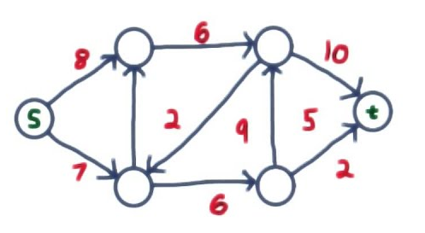
Flow networks
A flow network G =(V,E) is a directed graph in which each edge (u,v)ϵ E has a nonnegative capacity c(u, v)≥ 0.
if E contains an edge (u,v), then there is no edge (v,u) in the reverse direction.
Source s and sink t
Example:
Flow Network

Slide 3
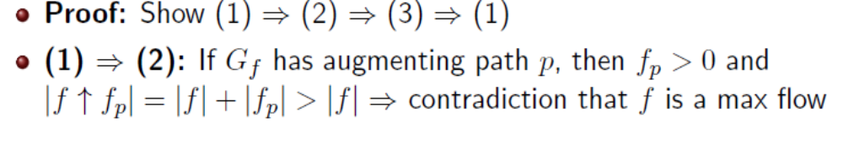
Theorem -Max-flow min-cut theorem
If f is a flow in a flow network G =(V,E) with source s and sink t , then the following conditions are equivalent:
1. f is a maximum flow in G.
2. The residual network G_{f} contains no augmenting paths.
3. |f|= c(S,T ) for some cut (S, T ) of G.

Slide 4
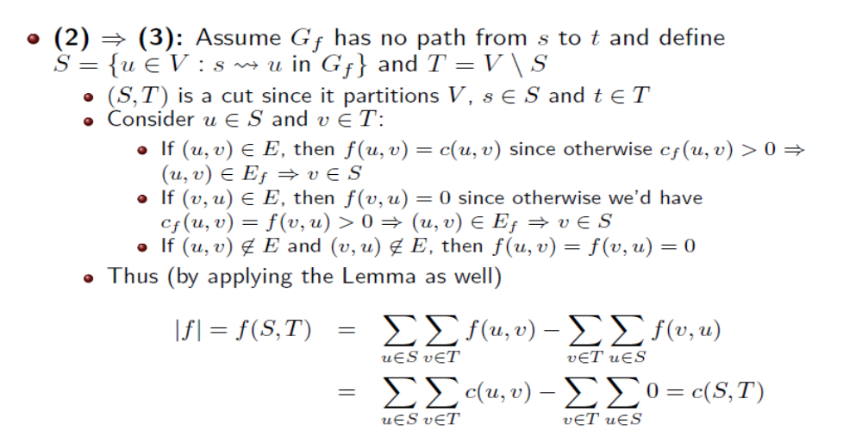
Theorem -Max-flow min-cut theorem

Slide 5
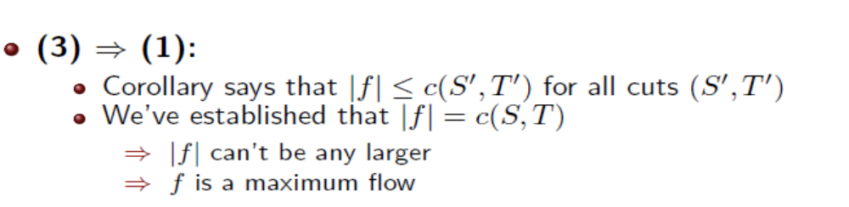
Theorem -Max-flow min-cut theorem

